Slide 1
Computer Organization
TOPIC 2.0 – Computer organization
TOPIC 2
2.1.11: Logic Gates

Slide 2

REVIEW REVIEW REVIEW REVIEW REVIEW REVIEW
THE WARM-UP QUESTION
Convert the decimal (base 10) number 192 into its binary (base 2) representation

Slide 3
REVIEW REVIEW REVIEW REVIEW REVIEW REVIEW
THE WARM-UP ANSWER
192 / 2 = 96 with remainder 0
96 / 2 = 48 with remainder 0
48 / 2 = 24 with remainder 0
24 / 2 = 12 with remainder 0
12 / 2 = 6 with remainder 0
6 / 2 = 3 with remainder 0
3 / 2 = 1 with remainder 1
1 / 2 = 0 with remainder 1
192₁₀ = 11000000₂

Slide 4
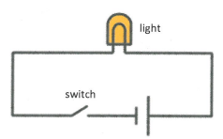
TOPIC 2.1.11 – BOOLEAN OPERATORS
BASIC CIRCUITS
Wires – carry electrical signal
Battery – supplies power through the circuit
Switch – Allows us to toggle the circuit on/off (input)
Light bulb – Allows us to see if the circuit is completed (output)
This circuit has two states
Switch is open, light is off
Switch is closed, light is on

Slide 5
TOPIC 2.1.11 – BOOLEAN OPERATORS
BASIC CIRCUITS
Note the usage of binary digits (bits) in the table to represent states
Input | Output
Switch | Light
Open (0) | Off (0)
Closed (1) | On (1)
switch

Slide 6
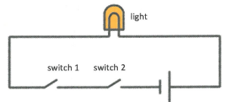
TOPIC 2.1.11 – BOOLEAN OPERATORS
AND GATE
Two switches instead of one in series
This is how the and condition in our programming functions
Goes from two states to four
Inputs |  | Output
Switch 1 | Switch 2 | Light - AND
Open (0) | Open (0) | Off (0)
Open (0) | Closed (1) | Off (0)
Closed (1) | Open (0) | Off (0)
Closed (1) | Closed (1) | On (1)
switch 1
switch 2

Slide 7
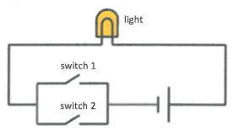
TOPIC 2.1.11 – BOOLEAN OPERATORS
OR GATE
Two switches instead of one in parallel
This is how the or condition in our programming functions
Goes from two states to four
Inputs |  | Output
Switch 1 | Switch 2 | Light - AND
Open (0) | Open (0) | Off (0)
Open (0) | Closed (1) | On (1)
Closed (1) | Open (0) | On (1)
Closed (1) | Closed (1) | On (1)
switch 1
switch 2

Slide 8
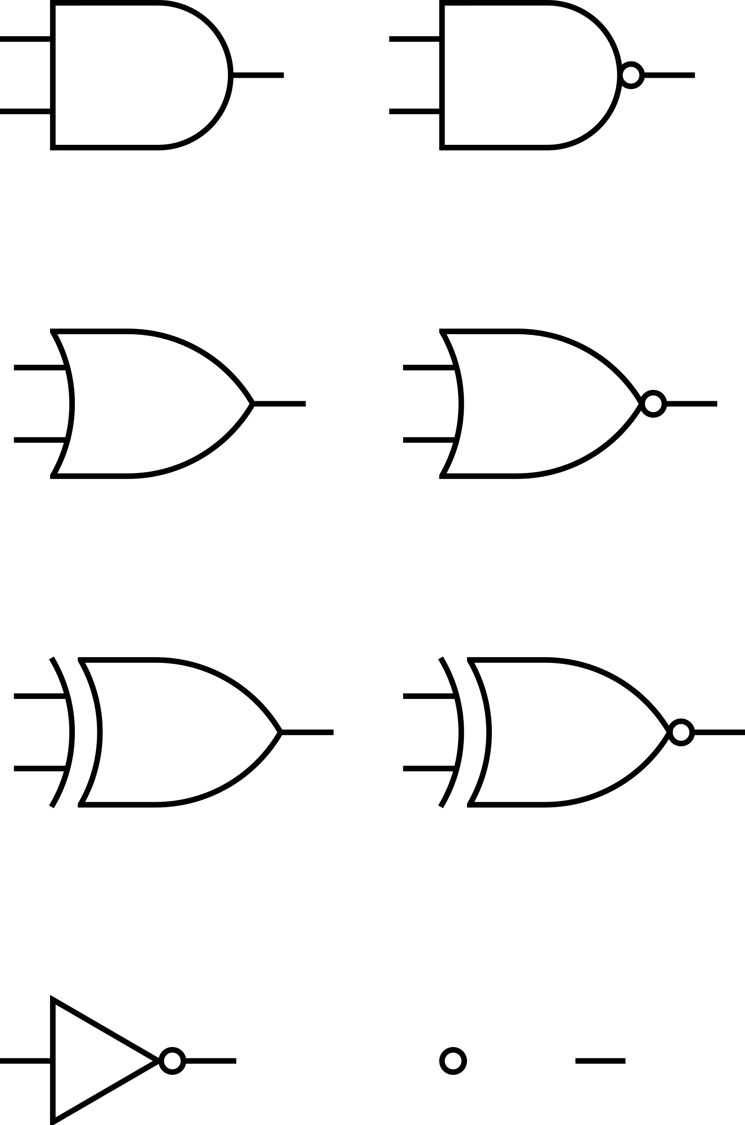
TOPIC 2.1.11 – BOOLEAN OPERATORS
Symbols
These are our most basic circuits, and so we have created simplified ways of representing the switch mechanisms when drawing diagrams
We refer to these as ‘logic gates’
Both gates take inputs for switches 1 and 2
The top gate, AND, returns 1 only if both switches are 1
Semicircle shape
The bottom gate, OR, returns 1 if either switch is 1
Arrow shape

Slide 9
TOPIC 2.1.11 – BOOLEAN OPERATORS
XOR
We have a few additional logic gates to complete Boolean logic
XOR – short for exclusive or
Mimics the way that we may communicate using ‘or’
Inputs |  | Output
0 (false) | 0 (false) | 0 (false)
0 (false) | 1 (true) | 1 (true)
1 (true) | 0 (false) | 1 (true)
1 (true) | 1 (true) | 0 (false)
switch 1
switch 2

Slide 10
TOPIC 2.1.11 – BOOLEAN OPERATORS
XOR GATE
XOR’s gate mimics the OR gate’s visual
Added line on back end of arrow symbol to indicate XOR not OR

Slide 11
TOPIC 2.1.11 – BOOLEAN OPERATORS
NOT
NOT simply serves to invert the switch value
Input | Output
0 (false) | 1 (true)
1 (true) | 0 (false)
switch 1
switch 2

Slide 12
TOPIC 2.1.11 – BOOLEAN OPERATORS
NOT GATE
NOT’s gate is a triangle with a dot at the end
The dot represents the inversion of the value
We will see this reappear later

Slide 13
TOPIC 2.1.11 – BOOLEAN OPERATORS
NAND
NAND – short for Not AND
Identical to the AND gate, but inverts the output value
Inputs |  | Output
0 (false) | 0 (false) | 1 (true)
0 (false) | 1 (true) | 1 (true)
1 (true) | 0 (false) | 1 (true)
1 (true) | 1 (true) | 0 (false)
switch 1
switch 2

Slide 14
TOPIC 2.1.11 – BOOLEAN OPERATORS
NAND GATE
NAND’s gate is the AND gate symbol with a dot to represent the inversion of the value

Slide 15
TOPIC 2.1.11 – BOOLEAN OPERATORS
NOR
NOR – short for Not OR
Identical to the OR gate, but inverts the output value
Inputs |  | Output
0 (false) | 0 (false) | 1 (true)
0 (false) | 1 (true) | 0 (false)
1 (true) | 0 (false) | 0 (false)
1 (true) | 1 (true) | 0 (false)
switch 1
switch 2

Slide 16
TOPIC 2.1.11 – BOOLEAN OPERATORS
COMPLEX LOGIC
How would we represent a Python statement like this using logic gates?
if condition1 == True and condition2 == True and condition3 == True:
Our current logic gates only support up to two inputs, so brainstorm how we can create this condition

Slide 17
TOPIC 2.1.11 – BOOLEAN OPERATORS
COMPLEX LOGIC
z
We can break our statement into (condition1 == True and condition 2 == True) and condition 3 == True

Slide 18
TOPIC 2.1.11 – BOOLEAN OPERATORS
COMPLEX LOGIC
How about a structure for (condition1 or not condition2) and condition3:

Slide 19
TOPIC 2.1.11 – BOOLEAN OPERATORS
z
COMPLEX LOGIC
How about a structure for (condition1 or not condition2) and condition3:

Slide 20
TOPIC 2.1.11 – BOOLEAN OPERATORS
COMPLEX LOGIC
One last question – try:
if (condition1 or not condition2) and (condition3 and condition4):

Slide 21
TOPIC 2.1.11 – BOOLEAN OPERATORS
z
COMPLEX LOGIC
if (condition1 or not condition2) and (condition3 and condition4):

Slide 22
TOPIC 2.1.11 – BOOLEAN OPERATORS
COMPLEX LOGIC
Good job!
Next time, we’ll be expanding more on the logic that underlies these, and increasing the complexity

Slide 23

TOPIC 2.0 – computer organization
Vocab to remember
AND
OR
NOT
NAND
NOR
XOR
Logic Gate

